Slide 1




SMART GLASS FOR BLIND PERSON
INTERNET OF THINGS
BARATH NIVASH KP(2116210701040)
BHARATHEESHWAR S(2116210701041)
PROJECT COORDINATOR:
Mr.S.Suresh Kumar M.E., (Ph.D.), Professor(SG) DEPARTMENT OF COMPUTER SCIENCE AND ENGINEERING

Slide 2
Abstract
This project aims to develop an innovative assistive device for visually impaired individuals, enhancing their navigation and interaction with their surroundings. The smart glasses integrate advanced technologies such as object detection, optical character recognition (OCR), environmental sensing, and emergency response features. Ultrasonic sensors detect nearby objects and obstacles, alerting the user via a buzzer. Upon a verbal query, an ESP32 camera captures and identifies objects using machine learning algorithms, and the identified object is communicated through a speaker. The device also uses OCR to read text on detected objects, converting it to speech output. Voice interaction is facilitated by a microphone, enabling hands-free operation. An accelerometer sensor monitors movements and detects falls or accidents, using the Google Maps API to determine the user's location via IP address and sending it to a mobile app to alert caregivers. A gas sensor monitors the air for harmful gases, alerting the user if dangerous levels are detected and relaying data to a mobile app for real-time monitoring. Built with the ESP32 microcontroller, the smart glasses manage sensor data processing, voice interaction, and communication with external devices, providing a multifaceted assistive device that significantly enhances the independence and safety of visually impaired individuals by offering real-time object detection, text reading, environmental monitoring, and emergency alerts.

Slide 3
Problem Statement
Visually impaired individuals face significant challenges in navigating and interacting with their environments independently. Traditional mobility aids such as canes and guide dogs provide limited assistance in detecting and identifying objects, reading text, and sensing environmental hazards. Moreover, in emergency situations, such as falls or exposure to harmful gases, visually impaired individuals may have difficulty seeking immediate help. There is a critical need for a comprehensive assistive device that can enhance the safety, mobility, and independence of visually impaired people by providing real-time object detection, text recognition, environmental monitoring, and emergency alert capabilities. This project aims to address these challenges by developing smart glasses equipped with advanced sensors, machine learning algorithms, and connectivity features to offer an all-in-one solution for visually impaired users.

Slide 4
Existing System
Human-Centric Assistance:
Blind individuals typically rely on human aides such as guide dogs or white canes to navigate their surroundings. Additionally, they may seek guidance from counselors or specialists who provide personalized advice based on interviews and assessments.
Limited Technological Aids:
While there exist some technological aids such as smartphone apps for text-to-speech or navigation, these solutions are often limited in their functionality and usability. They may require manual interaction, lack real-time environmental awareness, and may not address the full spectrum of needs for blind individuals.
Overall, the existing system for assisting blind individuals is primarily reliant on human assistance with limited technological augmentation. This approach may not fully leverage the potential of emerging technologies to provide comprehensive, real-time assistance tailored to the specific needs of blind individuals.
4

Slide 5
Proposed System
Object Detection & Recognition: Utilizes ultrasonic sensors and a camera module for real-time object detection and optical character recognition (OCR) to audibly identify objects and read text upon user request.
Navigation & Location Tracking: Integrates GPS and inertial sensors to provide auditory navigation guidance, alerts, and automatic emergency notifications with precise location tracking.
Environmental Monitoring: Equipped with gas detectors to continuously monitor air quality, providing audible alerts and detailed information about detected gases.
Voice Interaction & Personalization: Features voice recognition for natural language commands, allowing users to personalize settings and preferences.
Integration with Mobile App & Cloud Services: Seamlessly connects with a companion mobile app and cloud-based services for remote configuration, analytics, proactive alerts, and access to additional resources.

Slide 6
Aim and Objectives
Aim:
Develop a smart glass system tailored for blind individuals to enhance mobility, safety, and independence.
Objectives:
1.Real-time object detection and recognition.
2.Navigation assistance and location tracking.
3.Environmental monitoring and hazard detection.
4.Voice interaction and personalization.
5.ntegration with mobile app and cloud services.
6.Usability testing and user feedback

Slide 7
Literature Survey
Christos Liambas et.al [3] this system aims in providing an autonomous mobile system for dictating the text document through an image processing algorithm. This system uses Raspberry pi 2b, glasses with a camera fixed, a Bluetooth headset, Optical character recognition, Text to speech synthesizer, the system is developed by using the algorithm has three main phases calibration, line separation and data preparation for OCR and TTS, initially, the first phase of algorithm calibration takes place with the help of the camera, the video will be captured and analysed to guide the user through voice commands to hold the book in the proper position that is proper position should contain two pages and the next line separation phase helps in locating the text lines for each page, after that binarization and separation of each character will be read using OCR technology and converted into speech using TTS and that can be heard using earphones

Slide 8
Literature Survey
Vipul Samalam et.al [2] The system Speech Assistance using OCR for Visually Impaired was proposed by Vivekananda Education Society’s Institute of Technology, This system is a camera-based assistive text reading to help the visually impaired in reading the text present on the text labels, printed notes and products, This system uses the camera, audio microphone, Raspberry pi, Text to speech synthesiser, and Optical character recognition (OCR). In this system, the camera captures the image which will be processed by Optical character recognition then the binarization process starts that will convert the grey level image to binary this process helps to identify the extent of objects and also to concentrate on the shape analysis and the extracted text will be further going for segmentation and feature extraction then the identified text will be converted to speech using Text to speech synthesizer. This system cannot detect images and it doesn’t detect the numerical

Slide 9
Hardware & Software Requirements
Hardware:
1.Microcontroller Unit (MCU)
2.Sensors: Ultrasonic, esp32Camera, Accelerometer, Gas
3.Audio Output: Speaker
4.Connectivity Modules: Bluetooth, Wi-Fi
5.Power Supply: Rechargeable Battery
6.Design: Lightweight, Ergonomic, Modular
Software:
1.Embedded Software: Firmware, Algorithms
2.User Interface Software: GUI, Speech Synthesis
3.Mobile App: Companion App for Remote Control
4.Cloud Services Integration: AWS, Azure
5.Development Tools: IDE, SDKs

Slide 10
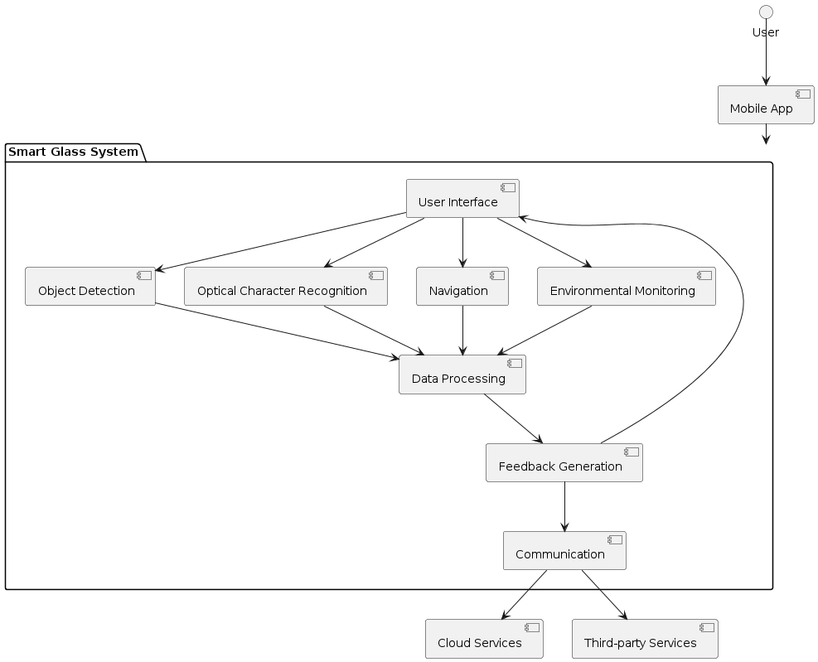
Architecture Diagram

Slide 11
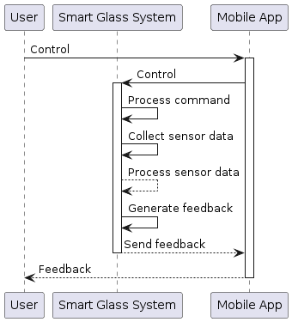
SEQUENCE DIAGRAM

Slide 12
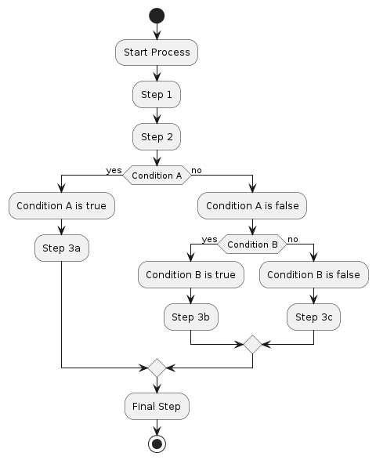
Flow Diagram

Slide 13
Functional Description
MODULES
1.User Interface:
The User Interface module serves as the primary interaction point for users, offering intuitive controls and customizable settings to tailor the experience to individual preferences. Its intuitive design and clear visual feedback facilitate seamless navigation and interaction, ensuring a user-friendly experience. Accessibility features such as text-to-speech and high-contrast modes enhance inclusivity, allowing users with diverse needs to effectively interact with the system. Continuous refinement based on user feedback ensures that the interface remains intuitive and responsive, driving user satisfaction and engagement.
2.Object Detection:
The Object Detection module employs ultrasonic sensors and advanced computer vision algorithms to identify objects in the user's environment. Real-time feedback provides users with essential information about the presence, distance, and size of detected objects, enhancing situational awareness. Leveraging machine learning techniques, the system continuously improves its ability to recognize and classify various objects, ensuring accuracy and reliability in diverse scenarios. Seamless integration with the User Interface module allows users to access object detection features effortlessly, empowering them to navigate their surroundings with confidence.

Slide 14
Functional Description
3.Optical Character Recognition (OCR):
The Optical Character Recognition (OCR) module utilizes sophisticated image processing algorithms to extract text from images captured by the smart glass camera. This enables users to interpret textual information such as signs, labels, and documents with ease. Seamless integration with the User Interface module allows users to access OCR functionality seamlessly, enhancing accessibility and usability. Multi-language support ensures that users can interpret text in their preferred language, promoting inclusivity. Ongoing optimization of OCR algorithms ensures accuracy and reliability, further enhancing user experience.
4.Navigation:
The Navigation module provides users with comprehensive navigation features, including turn-by-turn directions, route planning, and real-time updates. Leveraging GPS and mapping data, the system calculates optimal routes and guides users to their destinations using visual and auditory cues. Integration with the User Interface module allows for seamless access to navigation features, promoting ease of use. Real-time updates on traffic, road conditions, and points of interest ensure dynamic and responsive navigation experiences. Accessibility features such as voice-guided directions and tactile feedback support users with diverse needs, ensuring inclusivity and usability.

Slide 15
Functional Description
5.Environmental Monitoring:
The Environmental Monitoring module continuously detects and monitors environmental conditions such as air quality, temperature, and humidity. Integrated sensors collect real-time data, providing users with updates and alerts about potential hazards or comfort levels. User-friendly visualizations and notifications ensure that users can easily interpret and respond to environmental data. Seamless integration with the User Interface module allows users to access environmental monitoring features effortlessly, promoting user safety and well-being. Ongoing calibration and maintenance of sensors ensure accuracy and reliability in diverse environmental conditions
.
Job Matching:
The job matching module evaluates user qualifications against job requirements to ensure optimal alignment between users and job opportunities. Leveraging recommendation algorithms and user profile data, the backend assesses the suitability of job listings for individual users. Job matching algorithms consider factors such as skills, experience, location, and industry preferences to identify the most relevant job matches. Seamless integration with frontend components and backend services enables users to make informed decisions about their career paths, enhancing user engagement and satisfaction.

Slide 16
Sample coding
#include <WiFi.h>
#include <HTTPClient.h>
#include "esp_camera.h"
#include "Adafruit_VL53L0X.h"
const char* ssid = "YOUR_SSID";
const char* password = "YOUR_PASSWORD";
#define TRIG_PIN 12
#define ECHO_PIN 13
#define BUZZER_PIN 14
Adafruit_VL53L0X lox = Adafruit_VL53L0X();
#define CAMERA_MODEL_AI_THINKER
#include "camera_pins.h"
const char* OCR_ENDPOINT = "http://api.ocr-service.com/ocr";
void setup()

Slide 17
Sample coding
void loop() {
float distance = measureDistance();
if (distance > 0 && distance < 50) {
digitalWrite(BUZZER_PIN, HIGH);
delay(1000);
digitalWrite(BUZZER_PIN, LOW);
String ocrResult = captureAndSendImage();
Serial.println("OCR Result: " + ocrResult);
} else {
digitalWrite(BUZZER_PIN, LOW);
}
delay(2000);
}

Slide 18
Outputs and Final Results

Slide 19
Outputs and Final Results

Slide 20
Conclusion and Future Enhancements
Conclusion:
The Smart Glass for Blind Persons project advances assistive technology by enhancing independence and safety for visually impaired individuals. Integrating ultrasonic sensors for object detection, a camera for OCR, and environmental monitoring sensors, the smart glasses offer comprehensive support for daily navigation and interaction. This innovation improves the quality of life for blind individuals and paves the way for future advancements in assistive technologies.
Future Enhancements
1.Voice Commands: Add advanced voice recognition for natural interaction.
2.AR Feedback: Implement augmented reality for visual cues and overlays.
3.Health Monitoring: Integrate sensors for heart rate and blood pressure.
4.Personalized Assistance: Use machine learning to adapt to user preferences.
5.Enhanced Connectivity: Develop a mobile app for remote monitoring.

Slide 21
References
HBhowmick, A., & Hazarika, S. M. (2017). "An Insight into Assistive Technology for the Visually Impaired and Blind People: State-of-the-Art and Future Trends". Journal of Multimodal User Interfaces, 11(2), 149-172. DOI: 10.1007/s12193-016-0234-5
Manduchi, R., & Kurniawan, S. (2011). "Mobility-Related Accidents Experienced by People with Visual Impairment". Research and Practice in Visual Impairment and Blindness, 4(2), 44-54. DOI: 10.1179/174573011X12943261491915
Hub, A., Diepstraten, J., & Ertl, T. (2004). "Design and Development of an Indoor Navigation and Object Identification System for the Blind". Proceedings of the 6th International ACM SIGACCESS Conference on Computers and Accessibility, 147-152. DOI: 10.1145/1028630.1028658

Slide 22
Thank You

